Slide 1

AutoML Machine Learning and AI

Slide 2
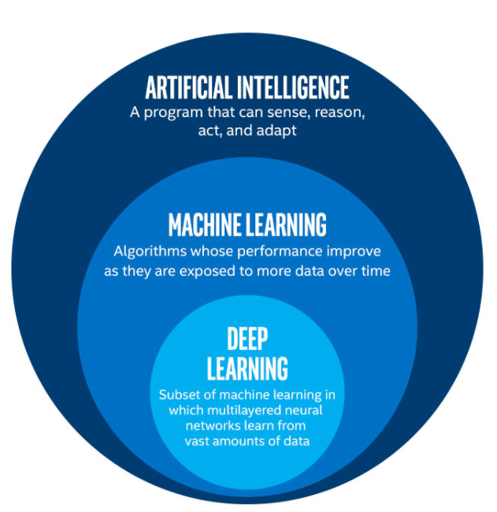
Artificial intelligence is the capability of a computer system to mimic human cognitive functions such as learning and problem-solving. Through AI, a computer system uses math and logic to simulate the reasoning that people use to learn from new information and make decision
Machine learning is an application of AI. It’s the process of using mathematical models of data to help a computer learn without direct instruction. This enables a computer system to continue learning and improving on its own, based on experience.
While AI and machine learning are very closely connected, they’re not the same. Machine learning is considered a subset of AI.

Slide 3



Principles of machine learning
Creating predictive models by finding relationships in data
1. Training data
(past observations)
2. Algorithm
(Generalizes the relationship between x and y as a function)
3. Model
(encapsulates the function)
[x₁,x₂,x₃], y
[x₁,x₂,x₃], y
[x₁,x₂,x₃], y
[x₁,x₂,x₃], y
[x₁,x₂,x₃], y
Training
y = f(x)
Features
(x)
Label
(y)
[x₁,x₂,x₃]
ŷ
Inferencing
4. Inferencing data
(unlabeled features)
Prediction
(inferred label)
Notes:
Machine learning is a programming technique used to create predictive models. Unlike typical programming, in which code is used to describe specific steps to produce an outcome; machine learning relies on the use of an algorithm to iteratively explore the relationship between the features of a data entity and the label the resulting model should predict. Machine learning algorithms are based on probability theory and statistics, and rely on large volumes of data with which to train the model.
At a simplistic level, a machine learning model is a function that takes the features of an observed entity (its characteristics) and performs a calculation on them to return a predicted label. It's common to refer in general to the features as x and the predicted label as y; so in effect, a machine learning model is the function f in the expression y = f(x).
The specific operation that the function performs on the features in order to calculate a value for the label is determined by the algorithm used to train the model.

Slide 4
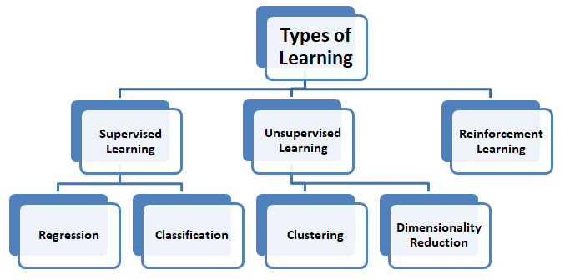

Slide 5
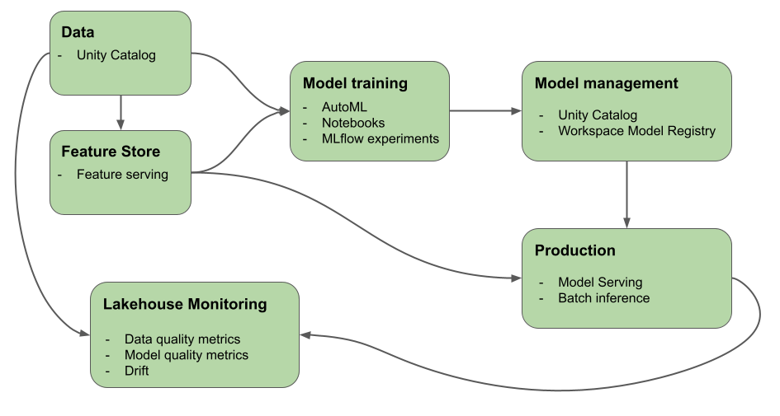
ML in Azure Databricks

Slide 6

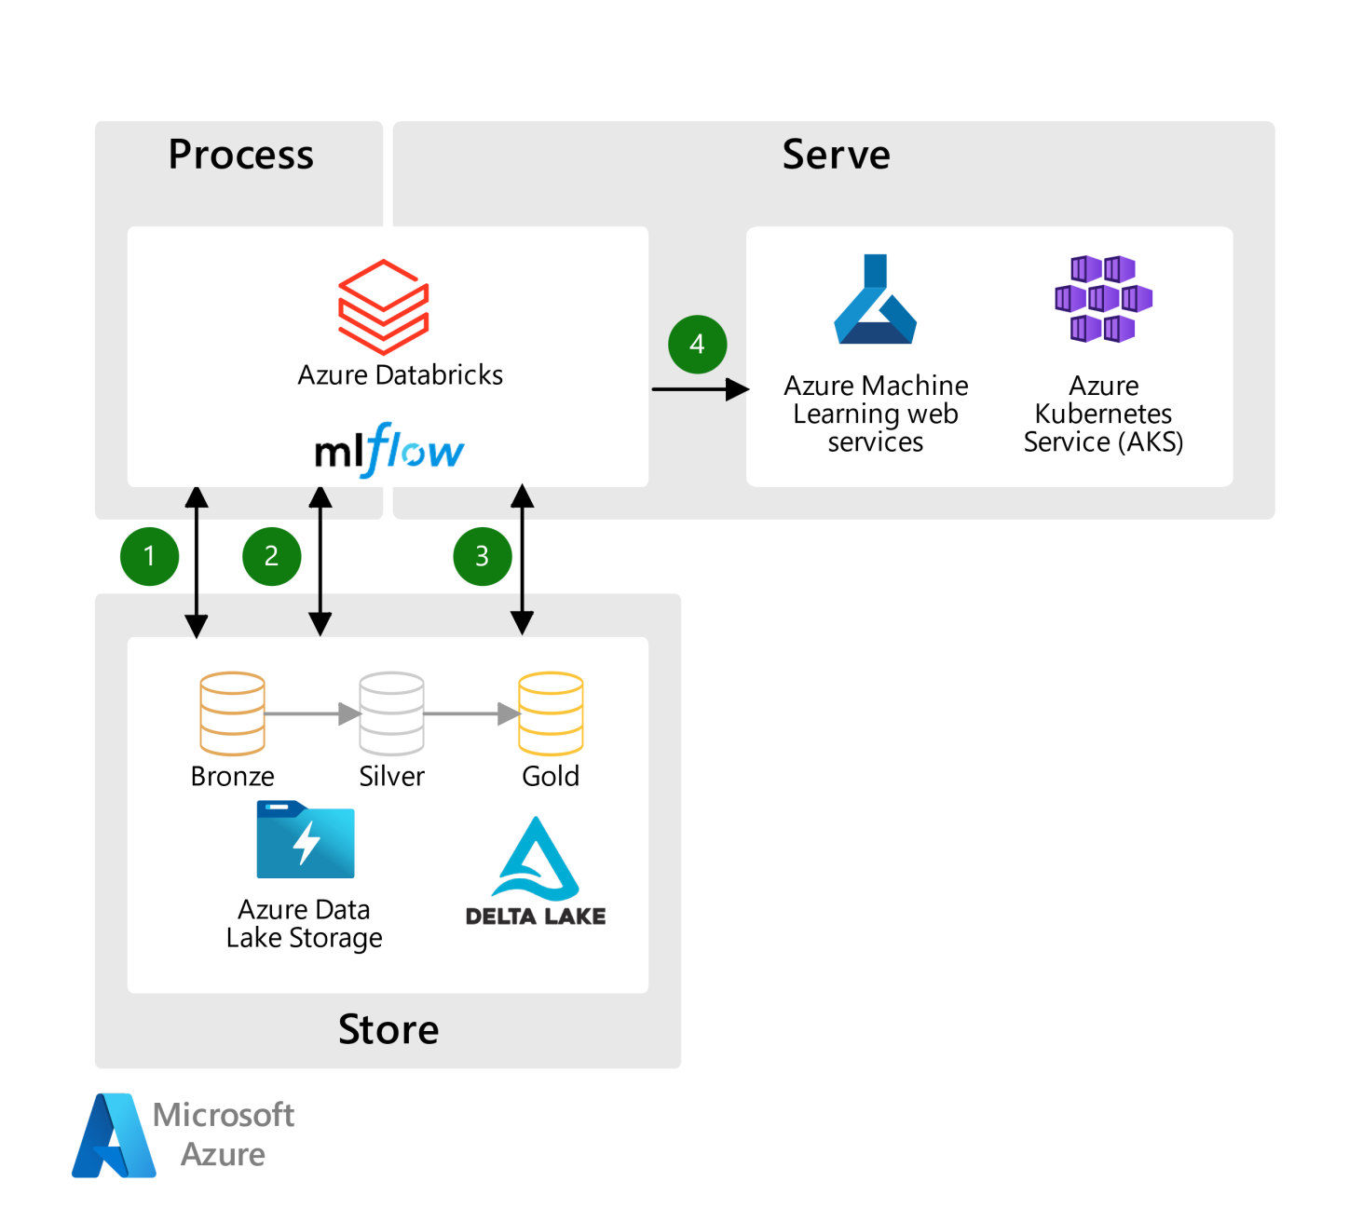
MLflow in Azure Databricks
ML lifecycle management in Databricks is provided by managed by MLflow
MLflow on Azure Databricks offers an integrated experience for tracking and securing training runs for machine learning and deep learning models.
MLflow Model Registry is a centralized model repository and a UI and set of APIs that enable you to manage the full lifecycle of MLflow Models.

Slide 7
Key Features of MLflow
MLflow is an open source platform for managing the end-to-end machine learning lifecycle.
Models: Allow you to manage and deploy models from a variety of ML libraries to a variety of model serving and inference platforms.
Projects: Allow you to package ML code in a reusable, reproducible form to share with other data scientists or transfer to production.
Model Registry: Allows you to centralize a model store for managing models’ full lifecycle stage transitions: from staging to production, with capabilities for versioning and annotating. Databricks provides a managed version of the Model Registry in Unity Catalog.
Model Serving: Allows you to host MLflow models as REST endpoints. Databricks provides a unified interface to deploy, govern, and query your served AI models.
Tracking: Allows you to track experiments to record and compare parameters and results.

Slide 8
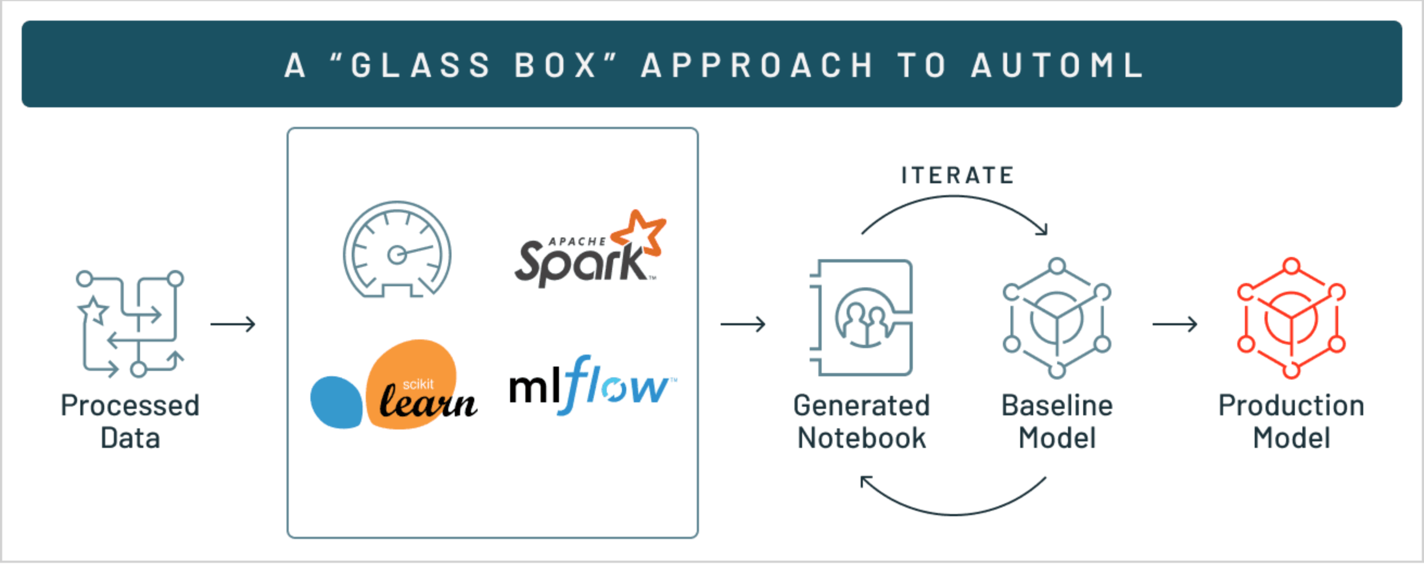
AutoML (using AI with and for AI)
AutoML simplifies the process of applying machine learning to your datasets by automatically finding the best algorithm and hyperparameter configuration for you.
AutoML depends on the databricks-automl-runtime package, which contains components that are useful outside of AutoML and also helps simplify the notebooks generated by AutoML training.

Slide 9
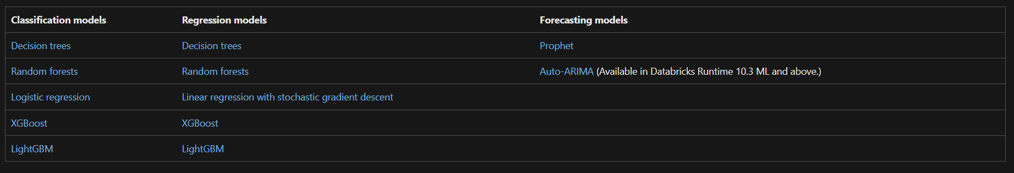
Algorithms supported by AutoML

Slide 10
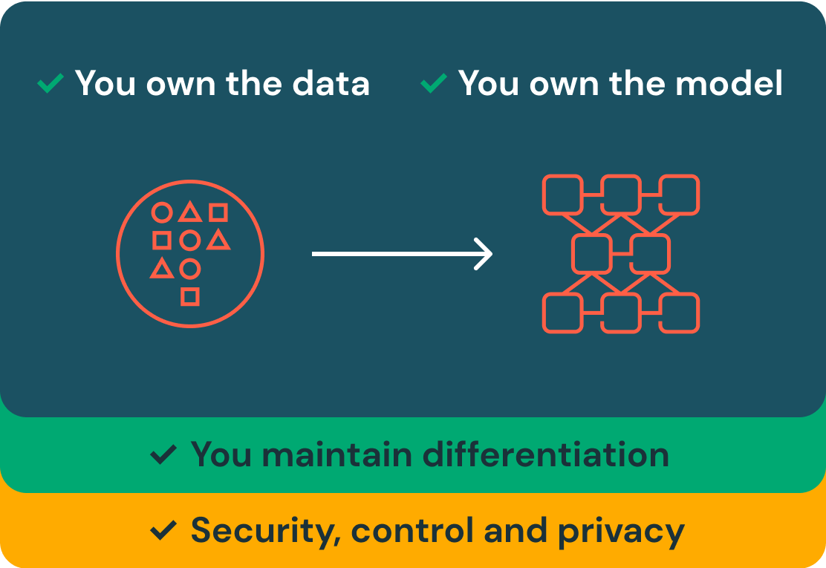
Mosaic AI in Azure Databricks
Mosaic AI is part of the Databricks Data Intelligence Platform, which unifies data, model training and production environments in a single solution.
Model Serving is a unified service for deploying, governing and querying AI models. This unified approach makes it easy to experiment with and productionize models. This includes:
Custom ML models like PyFunc, scikit-learn and LangChain
Foundation models (FMs) on Databricks like Llama 3, MPT, Mistral and BGE
Foundation models hosted elsewhere like ChatGPT, Claude 3, Cohere and Stable Diffusion
Mosaic AI enables organizations to securely and cost-effectively build production-quality compound AI systems integrated with their enterprise data.

Slide 11
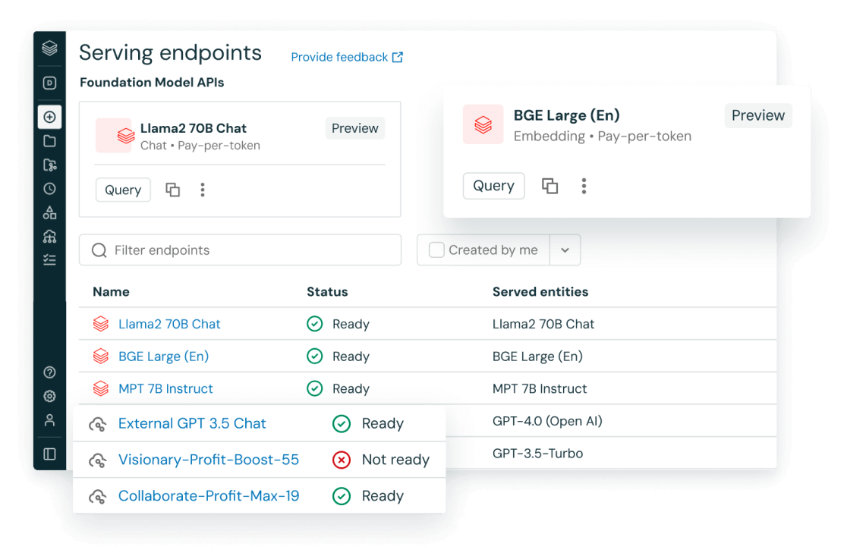

Slide 12
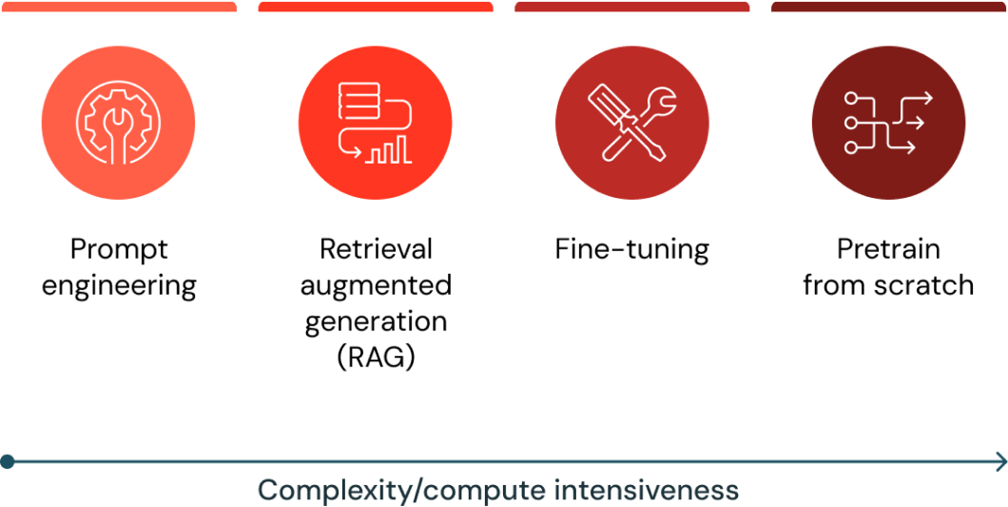
GenAI on Azure Databricks
Mosaic AI Agent Framework comprises a set of tools on Databricks designed to help developers build, deploy, and evaluate production-quality agents like Retrieval Augmented Generation (RAG) applications.
You can deploy Foundational Large Language Models in Azure Databricks. Base models, like DBRX Instruct, Meta-Llama-3.1-70B-Instruct, GTE-Large, and Mistral-7B are available for immediate use with pay-per-token pricing, and workloads that require performance guarantees, like fine-tuned model variants, can be deployed with provisioned throughput.

Slide 13
